Slide 3
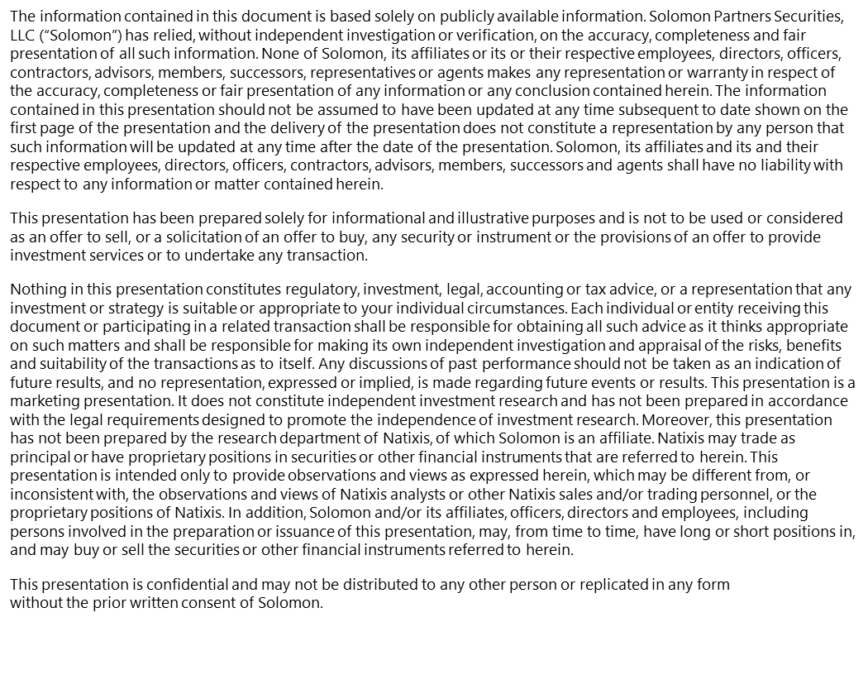
Disclaimer
Disclaimer Reminder:
Please reference the Macabacus Library to confirm the correct disclaimer for this deck’s intended use.
The information contained in this document is based solely on publicly available information. Solomon Partners Securities, LLC (“Solomon”) has relied, without independent investigation or verification, on the accuracy, completeness and fair presentation of all such information. None of Solomon, its affiliates or its or their respective employees, directors, officers, contractors, advisors, members, successors, representatives or agents makes any representation or warranty in respect of the accuracy, completeness or fair presentation of any information or any conclusion contained herein. The information contained in this document should not be assumed to have been updated at any time subsequent to the date shown on the first page of this document and the delivery of this document does not constitute a representation by any person that such information will be updated at any time after the date of this document. Solomon, its affiliates and its and their respective employees, directors, officers, contractors, advisors, members, successors and agents shall have no liability with respect to any information or matter contained herein.
This document has been prepared solely for informational and illustrative purposes and is not to be used or considered as an offer to sell, or a solicitation of an offer to buy, any security or instrument or the provisions of an offer to provide investment services or to undertake any transaction.
Nothing in this document constitutes regulatory, investment, legal, accounting or tax advice, or a representation that any investment or strategy is suitable or appropriate to your individual circumstances. Each individual or entity receiving this document or participating in a related transaction shall be responsible for obtaining all such advice as it thinks appropriate on such matters and shall be responsible for making its own independent investigation and appraisal of the risks, benefits and suitability of the transactions as to itself. Any discussions of past performance should not be taken as an indication of future results, and no representation, expressed or implied, is made regarding future events or results. This document is a marketing presentation. It does not constitute independent investment research and has not been prepared in accordance with the legal requirements designed to promote the independence of investment research. In addition, Solomon and/or its affiliates, officers, directors and employees, including persons involved in the preparation or issuance of this document, may, from time to time, have long or short positions in, and may buy or sell the securities or other financial instruments referred to herein.
This document is confidential and may not be distributed to any other person or replicated in any form without the prior written consent of Solomon.

